Slide 1




HOUSE PRICE PREDICTION USING MACHINE LEARNING
BY
USN of the student
1MJ17CS725
1MJ17CS731
1MJ17CS751
1MJ17CS744
Name of the student
M BHAVANA
MILLEE SAMUKCHAM
Y SREEJA REDDY
RIYA CHOUDHARY
Under the Guidance of
Dr. S.Umamaheswaran, Associate Professor
Dept of Computer Science
MVJ College of Engineering, Bangalore
Approved by AICTE |Affiliated to VTU | Recognized by UGC with 2(f) & 12(B) status |Accredited by NBA and NAAC
2

Slide 2
CONTENTS
Flow diagrams
System requirement
Output
Code
13)Advantages
14) Algorithm
15) Reference
Abstract
Introduction
Literature Survey
Existing System
Problem Statement
Proposed System
Objective
Modules
Approved by AICTE |Affiliated to VTU | Recognized by UGC with 2(f) & 12(B) status |Accredited by NBA and NAAC
3

Slide 3
ABSTRACT
With the rise in industrialization,people are also more careful nowadays when they are trying to buy a new house with their budgets and market strategies.
Till date,existing websites present only the house prices given by the owners and details of the house mostly infrastructure.
Some websites even provide comparision between diferent houses with the same infrastructure.But,some people are not aware of how much a house with a certain infrastructure is supposed to cost and are not able to detect how much is good enough to be able to detect frauds.
People also need other factors other than infrastructure to decide whether or not to buy a house Machine learning algorithm helps us in enhancing security alerts, ensuring public safety and improve medical enhancements.
We utilize logistic regression as our model because of its adaptable and probabilistic methodology on model selection.
Our result exhibit that our approach of the issue need to be successful, and has the ability to process predictions that would be comparative with other house cost prediction models. More over on other hand housing value indices, the advancement of a housing cost prediction that tend to the advancement of real estate policies schemes.This study utilizes machine learning algorithms as a research method that develops housing price prediction models.
Approved by AICTE |Affiliated to VTU | Recognized by UGC with 2(f) & 12(B) status |Accredited by NBA and NAAC
4

Slide 4
INTRODUCTION
Data is at the heart of technical innovations, achieving any result is now possible using predictive models. Machine learning is extensively used in this approach.
Machine learning means providing valid dataset and further on predictions are based on that, the machine itself learns how much importance a particular event may have on the entire system based on its pre-loaded data and accordingly predicts the result.
Various modern applications of this technique include predicting stock prices, predicting the possibility of an earthquake, predicting company sales and the list has endless possibilities. For our research project, we have considered Bangalore as our primary location and are predicting real-time house prices for various localities in and around Bangalore.
We have used various algorithms explained below in various combinations and the weight for each algorithm is given based on the accuracy percentage. After evaluating for various test runs we conclude that instead of an individual algorithm a series of algorithm yields better results.

Slide 5
LITERATURE SURVEY
Name of the Authors | Remarks
G.NagaSatish,Ch.V.Raghavendran, M.D.Sugnana Rao,Ch.Srinivasulu(International Journal of Innovative Technology and Exploring Engineering(IJITEE)) | They used Linear Regression ,Multiple Regression analysis , lasso regression technique and gradient boosting regression each on the training dataset to train the model individually and then print the predicted prices got from the best algorithm for a given test constraint. They have managed to prepare a model that gives users for a novel best approach that will take a gander at future value predictions. A worry for their system is that preparation time is longer and needs to use various processors and parallel the computations sequentially to decrease the preparation time.
Sayan Putatunda(Member,IEEE) | He proposed a system for proactive pricing of houses in classified advertisements in the Indian real estate market using PropTech. He aims to resolve the problems in regression technique.They also used advanced algorithms such as Random Forestand gradient boosting. They also experimented with Artificial neural networks with diferent hyper-parameters.And their study shows that Random forest method is the best performer in terms of prediction accuaracy

Slide 6
LITERATURE SURVEY
Name of the authors | Remarks
Bruno Klaus de Aquino Afonso,Luckeciano Carvalho Melo,William Dihanster Gomes de Oliveira,Samuel Bruno da Silva Sousa,Lilian Berton | Their work uses the application of two different methods for insight into the dat combined with powerful ML algorithms and then combined them into a final prediction. They used two architectures(enriched RF and KISS) separately for data enrichment.It showed that the Enriched RF works well with numeric features as it can derive rules not only depending on the value of an attribute but also on its presence or absence. However,it couldn’t handle image or text data.KISS,on the other hand can represent all kinds of data through the embedding layers.They concluded that combining the two methods yeilded the best result
Prof.Pradnya Patil,Darshil Shah,Harshad Rajput,Jay Chheda | Their proposed system uses data scraping with the use of UIPath Studio Platform to develop RPA flowchart. After the data is extracted,they perform data cleaning and then apply various algorithms. They claim that Random Forest quickly reaches some extent where more samples won’t imp[rove the accuracy. They conclude that CatBoost is a clear winner in terms of accuracy for dataset that contains both categorical as well as numerical features.

Slide 7
EXISTING SYSTEM
The real estate industry has become a competitive and nontransparent industry.
The data mining process in such an industry provides an advantage to the developers by processing those data, forecasting future trends and thus assisting them to make favorable knowledge-driven decisions.
The existing will build a predictive model to predict house price (price is a number from some defined range, so it will be regression task). For example, you want to sell a house and you don’t know the price which you can take — it can’t be too low or too high.
To find house price you usually try to find similar properties in your neighborhood and based on gathered data you will try to assess your house price.

Slide 8
PROBLEM STATEMENT
Prices of real estate properties are actually linked with our economy.
But we are not provided with the tools or accurate measures of house priceseven with the vast amount of data available.
It can be extremely difficult to figure out the right set of attributes that are contributing to understanding the buyer’s behaviour.Hence,our proposed system aims to use machine learning to predict the selling prices of houses based on various factors other than infrastructures.

Slide 9
PROPOSED SYSTEM
Our main focus here is to develop a model which predicts the property cost for a customer according to his\her interests. Our model analyses a set of parameters selected by the customer so as to find an ideal price according to their requirements and interest.
It uses a classical technique called logistic regression and collaborative filtering for prediction and tries to give an analysis of the results obtained.
Our dataset comprises of various essential parameters and data mining has been at the root of our system. We initially cleaned up our entire dataset and also truncated the outlier values.
Further, we weighed each parameter based on its importance in determining the pricing of the system and this led us to increase the value that each parameter withholds in the system.
We shortlisted 3 different machine learning algorithms and tested our system with different combinations that can guarantee best possibly reliability of our results. Even after that, we followed a unique approach to increase the accuracy, our survey led to a conclusion that the actual real estate value also depends on nearby local amenities such as railway station, supermarket, school, hospital, temple, parks etc.
And now we propose our unique approach that can counter this need. Now if we find any such public places in the circle we increase the value of the property correspondingly. We carried this out with manual examples and this gave us tremendous results in terms of accuracy in prediction.

Slide 10
OBJECTIVE
To develop a model which predicts the property cost for a customer according to his\her interests.
To Predict the house price.
To predict the selling prices of houses based on various factors other than infrastructures.
Approved by AICTE |Affiliated to VTU | Recognized by UGC with 2(f) & 12(B) status |Accredited by NBA and NAAC
7

Slide 11
MODULES
This project contains two modules:
Admin Module
User Module
Admin Module:
Admin can view his profile and edit his profile details.
He can also view the users and delete any of them.
He can upload the dataset and view it.
He can change his password and logout.
User Module:
A user can login and view his/her details. He/she can also edit the profile details.
A user can check for the city, area, and type of house he/she is looking for and results will be displayed for the same.
A user can also check for house prediction based on the city, area, and budget he has.
Finally, he can check for house prediction based on entire city.
He/she has the ability to change the password. And can logout from his profile.

Slide 12
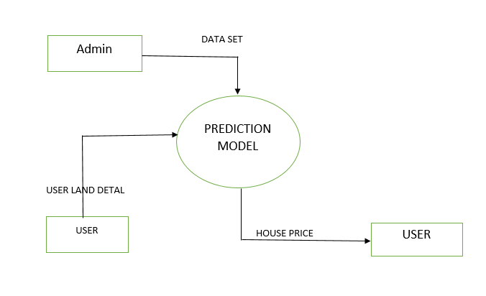
DATAFLOW DIAGRAM
CONTEXT DIAGRAM

Slide 13
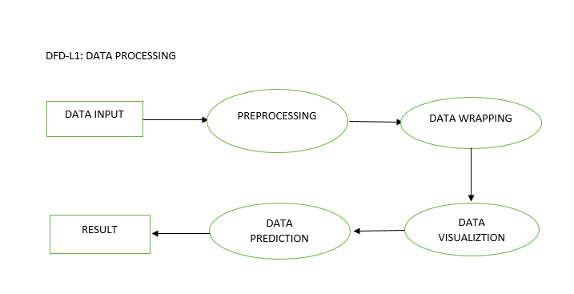
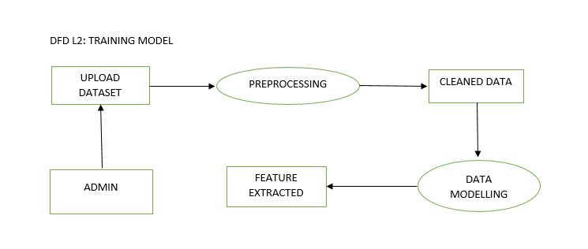
DATAFLOW DIAGRAM
DFD LEVEL-1
DFD LEVEL-2A

Slide 14
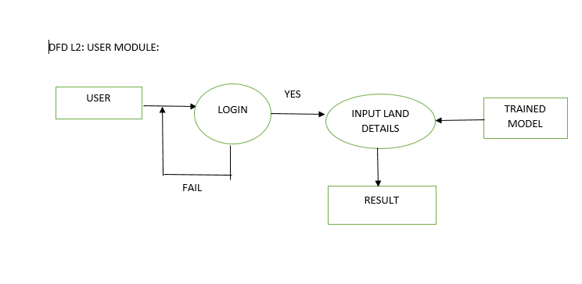
DATAFLOW DIAGRAM
DFD LEVEL-2B

Slide 15
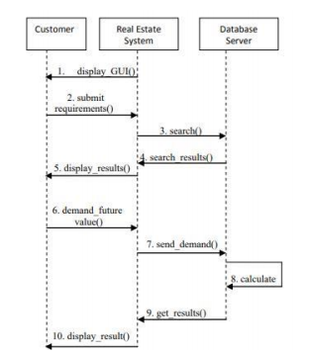


SEQUENCE DIAGRAMM
Approved by AICTE |Affiliated to VTU | Recognized by UGC with 2(f) & 12(B) status |Accredited by NBA and NAAC
8

Slide 16
SYSTEM REQUIREMENTS
HARDWARE REQUIREMENTS
System : Pentium IV 2.4 Ghz
Ram : 4GB
Hard disk : 500GB
Any desktop/laptop system with above configuration or higher level
SYSTEM REQUIREMENTS
Operating system : Windows XP / 7
Coding Language : Java (Jdk 1.7)
Web Technology : Servlet, JSP
Web Server : TomCAT 7.0
IDE : Eclipse Galileo
Database : My-SQL 5.0
UGI for DB : SQLyog
JDBC Connection : Type 4 - Native Drive

Slide 17
ADVANTAGES
To provide an accurate prediction of housing.
The system makes optimal use of Logistic Regression, Collaborative filtering.
The efficiency of the algorithm has been further increased with use of Neural networks.

Slide 18
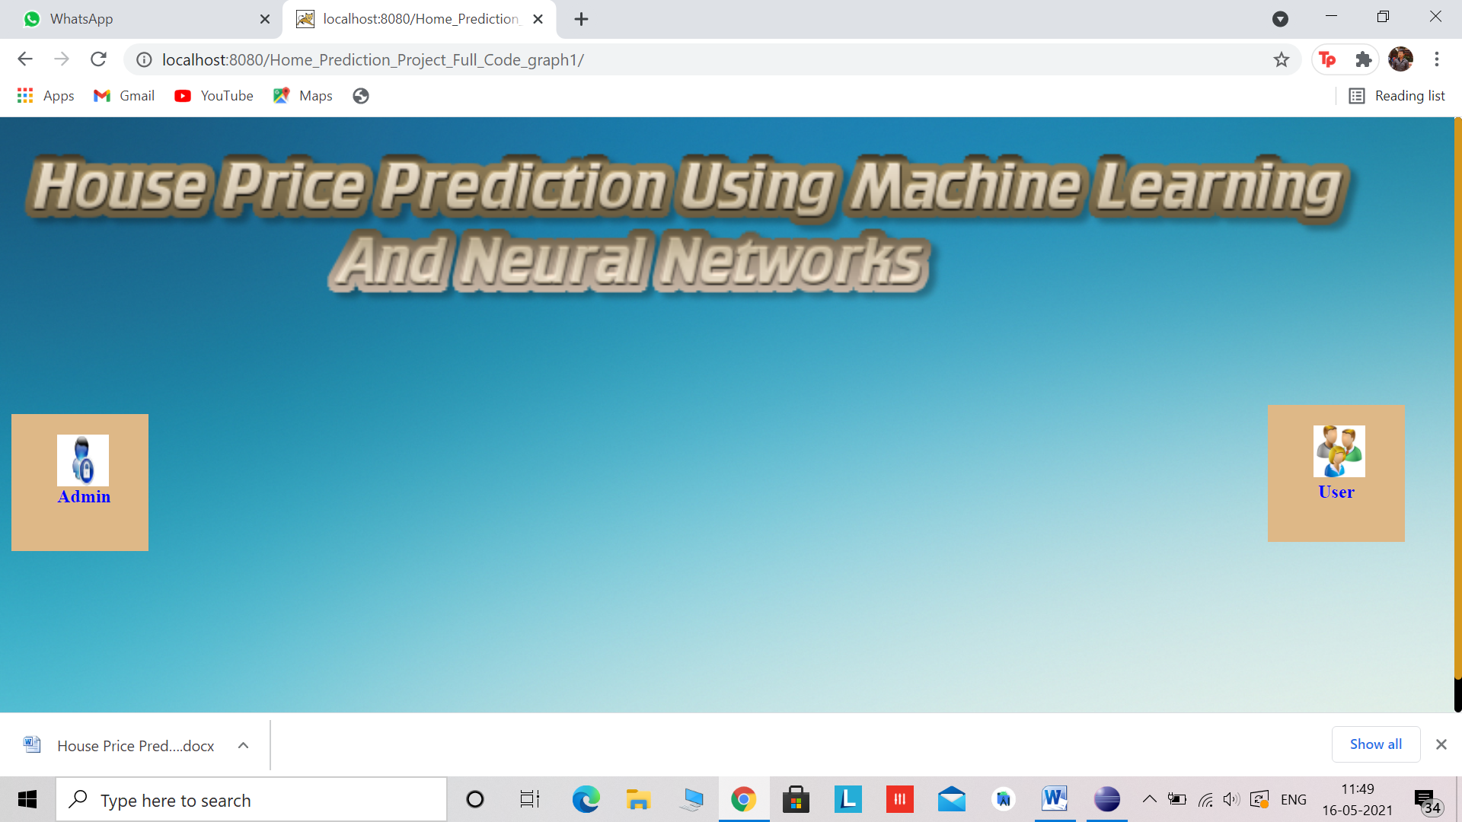
OUTPUT
Home Page

Slide 19
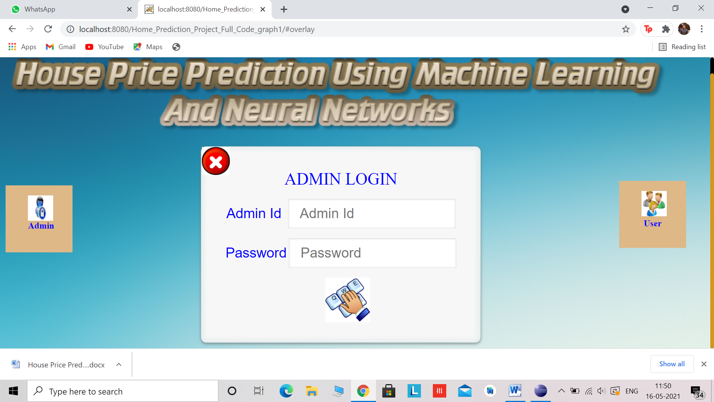
OUTPUT
Admin Login

Slide 20
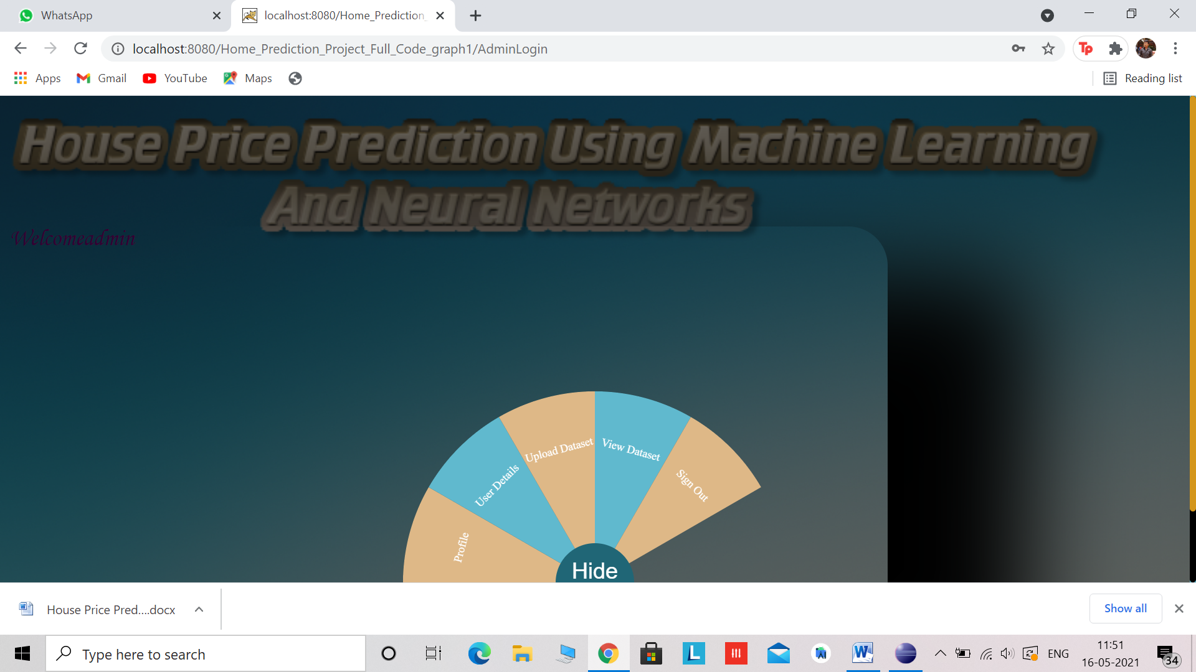
OUTPUT
Admin homepage

Slide 21

OUTPUT
Admin can view and edit his details

Slide 22
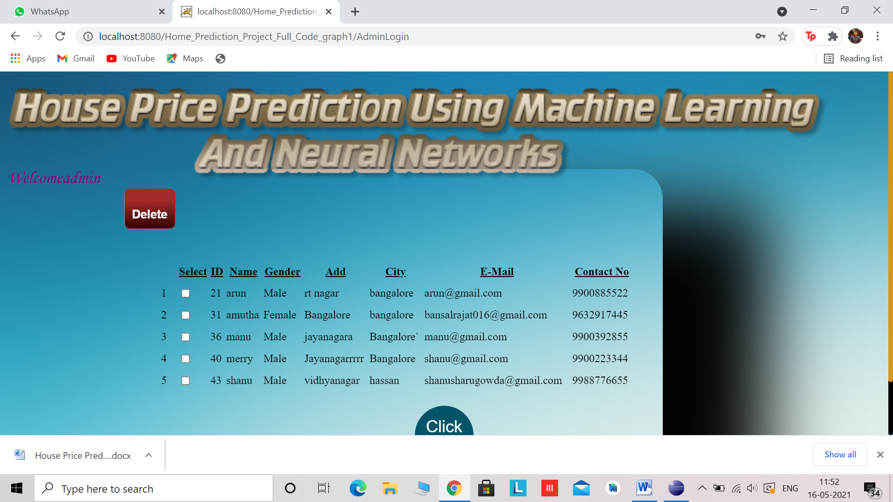
OUTPUT
Viewing and deleting user details

Slide 23
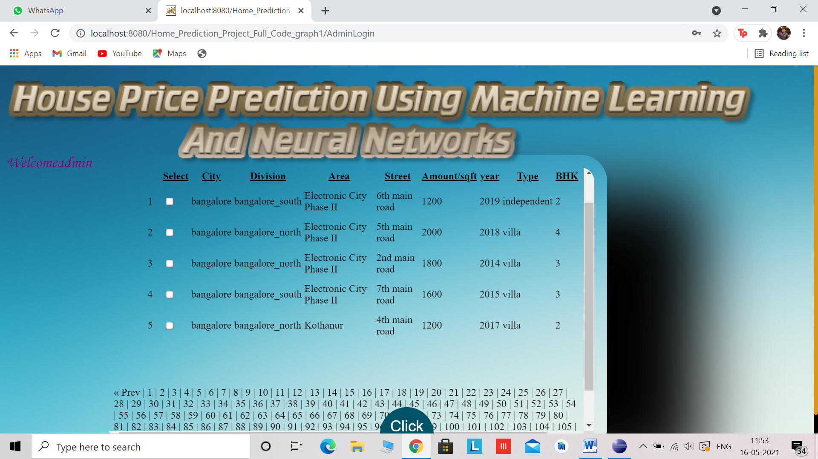
OUTPUT
Upload and view dataset

Slide 24
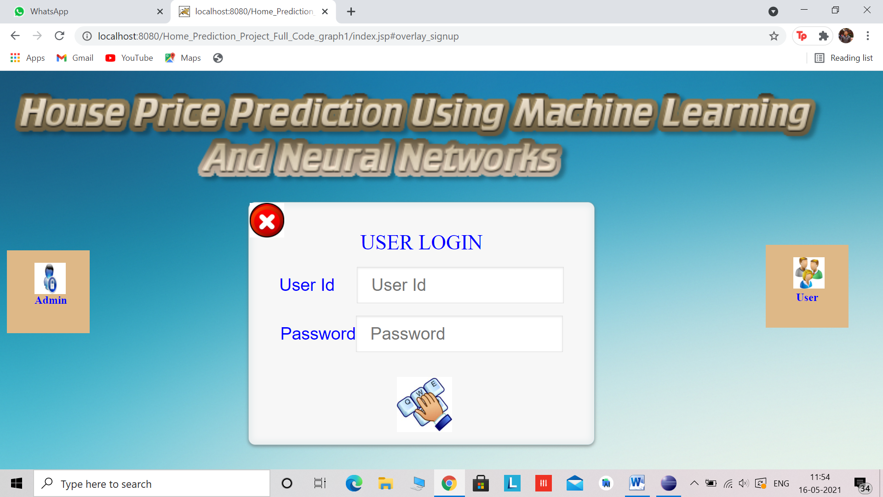
OUTPUT
USER LOGIN

Slide 25
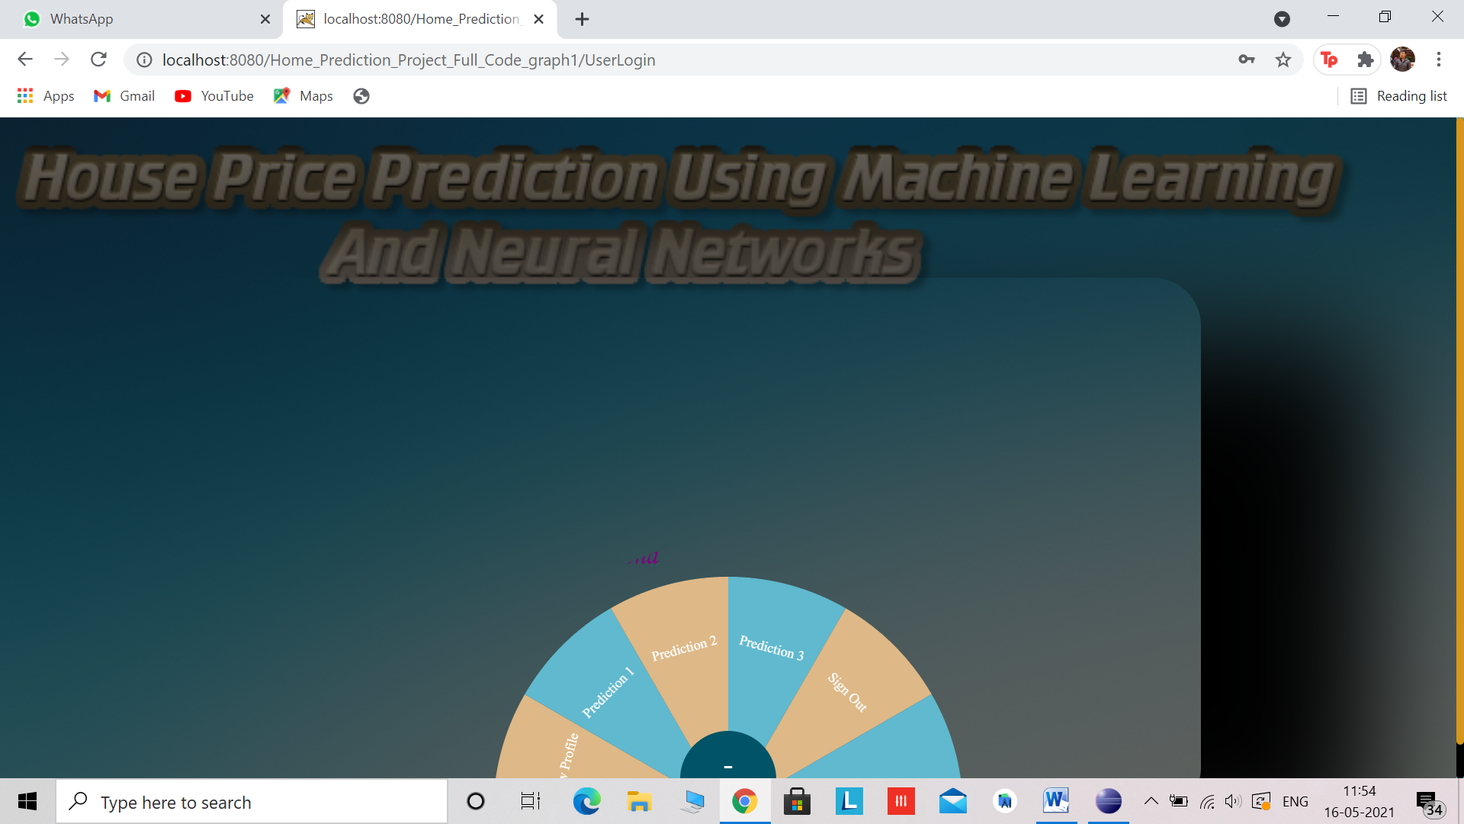
OUTPUT
User Homepage

Slide 26

OUTPUT
User can view their profile and edit details

Slide 27
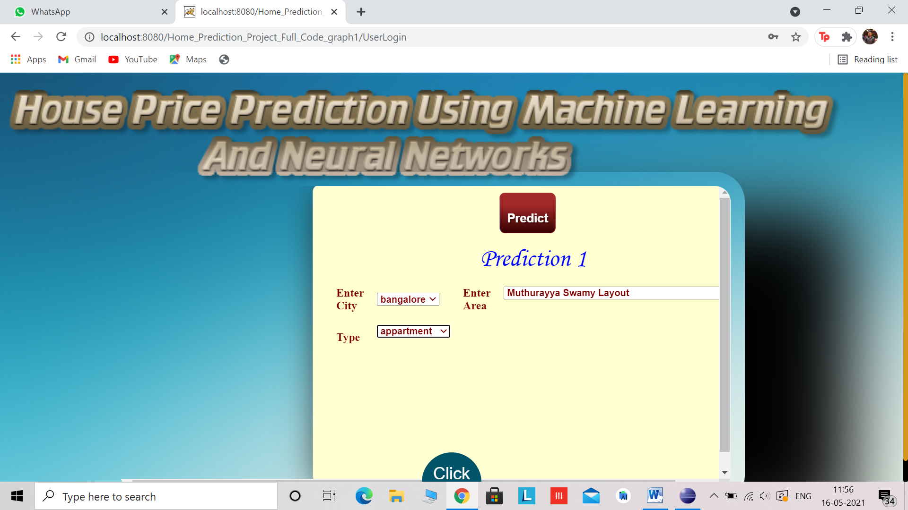
OUTPUT
Prediction 1

Slide 28

OUTPUT
Prediction 1 Result

Slide 29

OUTPUT
Prediction 2

Slide 30

OUTPUT
Results for prediction 2

Slide 31

OUTPUT
Results for Prediction 3

Slide 32
ALGORITHM
Logistic regression is a supervised learning classification algorithm used to predict the probability of a target variable. It is one of the simplest ML algorithms that can be used for various classification problems such as spam detection, Diabetes prediction, cancer detection etc.
Logistic regression is used to calculate the probability of a binary event occurring, and to deal with issues of classification. For example, predicting if an incoming email is spam or not spam, or predicting if a credit card transaction is fraudulent or not fraudulent. In a medical context, logistic regression may be used to predict whether a tumor is benign or malignant. In marketing, it may be used to predict if a given user (or group of users) will buy a certain product or not. An online education company might use logistic regression to predict whether a student will complete their course on time or not.
As we can see, logistic regression is used to predict the likelihood of all kinds of “yes” or “no” outcomes. By predicting such outcomes, logistic regression helps data analysts (and the companies they work for) to make informed decisions. In the grand scheme of things, this helps to both minimize the risk of loss and to optimize spending in order to maximize profits.

Slide 33
ALGORITHM
PSEUDOCODE
Read the dataset.
Split the datset into test and train dataset
Traverse training set samples
Calculate the weight score of sample
The gradient (cost) calculation of each dimension

Slide 34
ALGORITHM
Update w
Build the model
Train the model using the train set
8. Take inputs from the front end and pass them to the model
9. Display the result in the front end
An Autonomous I n s t i t u t i o n , A f f i l i a t e d t o VTU, Belagavi,, Approved By AICTE, New D e l h i , Recognized by UGC w i t h 2 ( f ) & 12 ( B) s t a t u s , A c c r edi ted By NBAand NAAC

Slide 35
ALGORITHM
Linear regression is a linear model, e.g. a model that assumes a linear relationship between the input variables (x) and the single output variable (y). More specifically, that y can be calculated from a linear combination of the input variables (x).
When there is a single input variable (x), the method is referred to as simple linear regression. When there are multiple input variables, literature from statistics often refers to the method as multiple linear regression.
Linear regression is an attractive model because the representation is so simple.
The representation is a linear equation that combines a specific set of input values (x) the solution to which is the predicted output for that set of input values (y).
As such, both the input values (x) and the output value are numeric.The linear equation assigns one scale factor to each input value or column, called a coefficient and represented by the capital Greek letter Beta (B). One additional coefficient is also added, giving the line an additional degree of freedom (e.g. moving up and down on a two-dimensional plot) and is often called the intercept or the bias coefficient.

Slide 36
REFERENCES
[1] A. Adair, J. Berry, W. McGreal, Hedonic modeling, housing submarkets and residential valuation, Journal of Property Research, 13 (1996) 67-83.
[2] O. Bin, A prediction comparison of housing sales prices by parametric versus semi-parametric regressions, Journal of Housing Economics, 13 (2004) 68-84.
[3] T. M. Oshiro, P. S. Perez, and J. A. Baranauskas, “How many trees in a random forest?” In Lecture Notes in Computer Science (including subseries Lecture Notes in Artificial Intelligence and Lecture Notes in Bioinformatics), vol. 7376 LNAI, 2012, pp. 154–168, ISBN: 9783642315367. DOI: 10 . 1007 / 978 - 3 - 642 - 31537-4\ 13
[4] J. Schmidhuber, “Multi-column deep neural networks for image classification,” in Proceedings of the 2012 IEEE Conference on Computer Vision and Pattern Recognition (CVPR), ser. CVPR ’12, Washington, DC, USA: IEEE Computer Society, 2012, pp. 3642–3649, ISBN: 978-1-4673-1226-4. [Online].
[5] T. Kauko, P. Hooimeijer, J. Hakfoort, Capturing housing market segmentation: An alternative approach based on neural network modeling, Housing Studies, 17 (2002) 875-894
Approved by AICTE |Affiliated to VTU | Recognized by UGC with 2(f) & 12(B) status |Accredited by NBA and NAAC
24

Slide 37

MVJ College of Engineering Near ITPB, Whitefield Bangalore-560 067
M: principalengg@mvjce.edu.in P: +91 80 4299 1040
Thank You
An Autonomous I n s t i t u t i o n , A f f i l i a t e d t o VTU, Belagavi,, Approved By AICTE, New D e l h i , Recognized by UGC w i t h 2 ( f ) & 12 ( B) s t a t u s , A c c r edi ted By NBAand NAAC
15

